Slide 1
CS583 – Data Mining and Text Mining
Course Web Page
http://www.cs.uic.edu/~liub/teach/cs583-fall-05/cs583.html

Slide 2
General Information
Instructor: Bing Liu
  Email: liub@cs.uic.edu
  Tel: (312) 355 1318
  Office: SEO 931
Course Call Number: 22887
Lecture times:
  11:00am-12:15pm, Tuesday and Thursday
Room: 319 SH
Office hours: 2:00pm-3:30pm, Tuesday & Thursday (or by appointment)

Slide 3
Course structure
The course has three parts:
  Lectures - Introduction to the main topics
  Programming projects
    2 programming assignments.
    To be demonstrated to me
  Research paper reading
    A list of papers will be given
Lecture slides will be made available at the course web page

Slide 4
Programming projects
Two programming projects
To be done individually by each student
You will demonstrate your programs to me to show that they work
You will be given a sample dataset
The data to be used in the demo will be different from the sample data

Slide 5
Grading
Final Exam: 50%
Midterm: 30%
  1 midterm
Programming projects: 20%
  2 programming assignments.
Research paper reading (some questions from the papers will appear in the final exam).

Slide 6
Prerequisites
Knowledge of
  basic probability theory
  algorithms

Slide 7
Teaching materials
Text
  Reading materials will be provided before the class
Reference texts:
  Data mining: Concepts and Techniques, by Jiawei Han and Micheline Kamber, Morgan Kaufmann, ISBN 1-55860-489-8.
  Principles of Data Mining, by David Hand, Heikki Mannila, Padhraic Smyth, The MIT Press, ISBN 0-262-08290-X.
  Introduction to Data Mining, by Pang-Ning Tan, Michael Steinbach, and Vipin Kumar, Pearson/Addison Wesley, ISBN 0-321-32136-7.
  Machine Learning, by Tom M. Mitchell, McGraw-Hill, ISBN 0-07-042807-7
  Modern Information Retrieval, by Ricardo Baeza-Yates and Berthier Ribeiro-Neto, Addison Wesley, ISBN 0-201-39829-X
Data mining resource site: KDnuggets Directory

Slide 8
Topics
Introduction
Data pre-processing
Association rule mining
Classification (supervised learning)
Clustering (unsupervised learning)
Post-processing of data mining results
Text mining
Partial/Semi-supervised learning
Introduction to Web mining

Slide 9
Any questions and suggestions?
Your feedback is most welcome!
  I need it to adapt the course to your needs.
Share your questions and concerns with the class – very likely others may have the same.
No pain no gain – no magic
  The more you put in, the more you get
  Your grades are proportional to your efforts.

Slide 10
Rules and Policies
Statute of limitations: No grading questions or complaints, no matter how justified, will be listened to one week after the item in question has been returned.
Cheating: Cheating will not be tolerated. All work you submitted must be entirely your own. Any suspicious similarities between students' work will be recorded and brought to the attention of the Dean. The MINIMUM penalty for any student found cheating will be to receive a 0 for the item in question, and dropping your final course grade one letter. The MAXIMUM penalty will be expulsion from the University.
Late assignments: Late assignments will not, in general, be accepted. They will never be accepted if the student has not made special arrangements with me at least one day before the assignment is due. If a late assignment is accepted it is subject to a reduction in score as a late penalty.

Slide 11
Introduction to Data Mining

Slide 12
What is data mining?
Data mining is also called knowledge discovery and data mining (KDD)
Data mining is
  extraction of useful patterns from data sources, e.g., databases, texts, web, image.
Patterns must be:
  valid, novel, potentially useful, understandable

Slide 13
Example of discovered patterns
Association rules:
  “80% of customers who buy cheese and milk also buy bread, and 5% of customers buy all of them together”
  Cheese, Milk→ Bread [sup =5%, confid=80%]

Slide 14
Main data mining tasks
Classification:
  mining patterns that can classify future data into known classes.
Association rule mining
  mining any rule of the form X → Y, where X and Y are sets of data items.
Clustering
  identifying a set of similarity groups in the data

Slide 15
Main data mining tasks (cont …)
Sequential pattern mining:
  A sequential rule: A→ B, says that event A will be immediately followed by event B with a certain confidence
Deviation detection:
  discovering the most significant changes in data
Data visualization: using graphical methods to show patterns in data.

Slide 16
Why is data mining important?
Rapid computerization of businesses produce huge amount of data
How to make best use of data?
A growing realization: knowledge discovered from data can be used for competitive advantage.

Slide 17
Why is data mining necessary?
Make use of your data assets
There is a big gap from stored data to knowledge; and the transition won’t occur automatically.
Many interesting things you want to find cannot be found using database queries
  “find me people likely to buy my products”
  “Who are likely to respond to my promotion”

Slide 18
Why data mining now?
The data is abundant.
The data is being warehoused.
The computing power is affordable.
The competitive pressure is strong.
Data mining tools have become available

Slide 19
Related fields
Data mining is an emerging multi-disciplinary field:
  Statistics
  Machine learning
  Databases
  Information retrieval
  Visualization
  etc.

Slide 20
Data mining (KDD) process
Understand the application domain
Identify data sources and select target data
Pre-process: cleaning, attribute selection
Data mining to extract patterns or models
Post-process: identifying interesting or useful patterns
Incorporate patterns in real world tasks

Slide 21
Data mining applications
Marketing, customer profiling and retention, identifying potential customers, market segmentation.
Fraud detection
identifying credit card fraud, intrusion detection
Scientific data analysis
Text and web mining
Any application that involves a large amount of data …

Slide 22
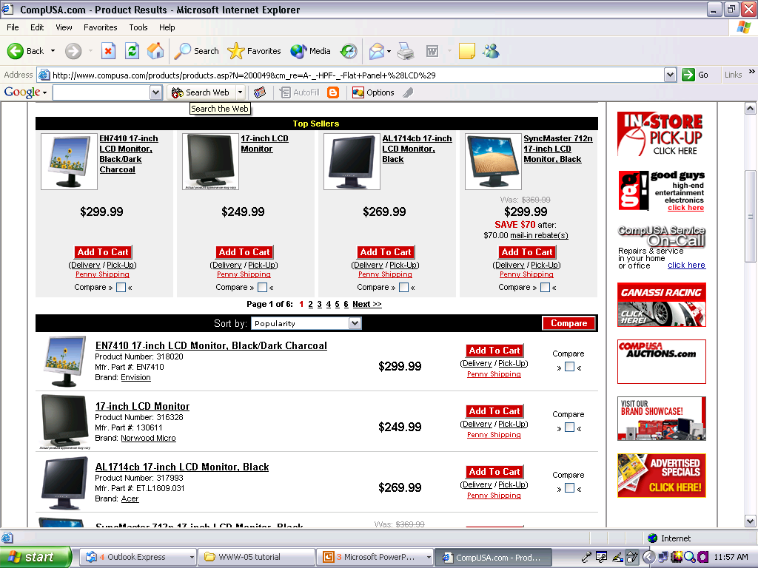
Web data extraction
Data region1
A data record
A data record
Data region2

Slide 23
Align and extract data items (e.g., region1)
image1 | EN7410 17-inch LCD Monitor Black/Dark charcoal |  | $299.99 |  | Add to Cart | (Delivery / Pick-Up ) | Penny Shopping | Compare
image2 | 17-inch LCD Monitor |  | $249.99 |  | Add to Cart | (Delivery / Pick-Up ) | Penny Shopping | Compare
image3 | AL1714 17-inch LCD Monitor, Black |  | $269.99 |  | Add to Cart | (Delivery / Pick-Up ) | Penny Shopping | Compare
image4 | SyncMaster 712n 17-inch LCD Monitor, Black | Was: $369.99 | $299.99 | Save $70 After: $70 mail-in-rebate(s) | Add to Cart | (Delivery / Pick-Up ) | Penny Shopping | Compare

Slide 24
Opinion Analysis
Word-of-mouth on the Web
The Web has dramatically changed the way that consumers express their opinions.
One can post reviews of products at merchant sites, Web forums, discussion groups, blogs
Techniques are being developed to exploit these sources.
Benefits of Review Analysis
  Potential Customer: No need to read many reviews
  Product manufacturer: market intelligence, product benchmarking

Slide 25
Feature Based Analysis & Summarization
Extracting product features (called Opinion Features) that have been commented on by customers.
Identifying opinion sentences in each review and deciding whether each opinion sentence is positive or negative.
Summarizing and comparing results.

Slide 26
An example
GREAT Camera., Jun 3, 2004
Reviewer: jprice174 from Atlanta, Ga.
I did a lot of research last year before I bought this camera... It kinda hurt to leave behind my beloved nikon 35mm SLR, but I was going to Italy, and I needed something smaller, and digital.
The pictures coming out of this camera are amazing. The 'auto' feature takes great pictures most of the time. And with digital, you're not wasting film if the picture doesn't come out. …
….
Summary:
Feature1: picture
Positive: 12
The pictures coming out of this camera are amazing.
Overall this is a good camera with a really good picture clarity.
…
Negative: 2
The pictures come out hazy if your hands shake even for a moment during the entire process of taking a picture.
Focusing on a display rack about 20 feet away in a brightly lit room during day time, pictures produced by this camera were blurry and in a shade of orange.
Feature2: battery life
…

Slide 27
Visual Comparison
+
Summary of reviews of Digital camera 1
_
Picture
Battery
Zoom
Size
Weight
+
Comparison of reviews of
Digital camera 1
Digital camera 2
_

